Slide 1
Maslow’s Hierarchy of NEEDS
Sukhdeep Chopra

Slide 2
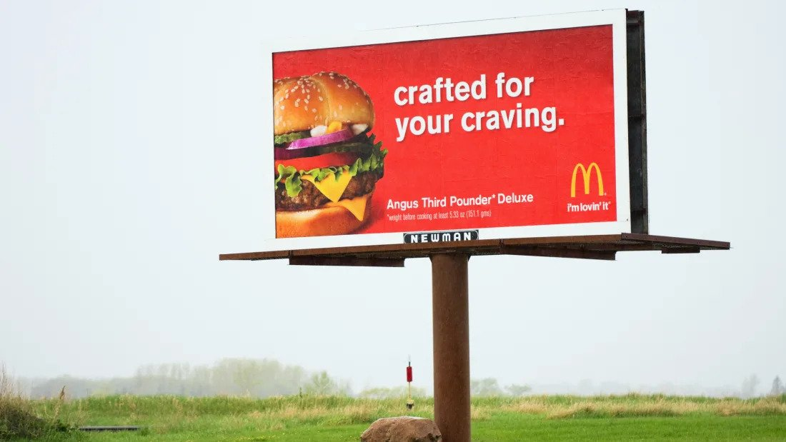
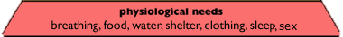
Physiological Needs
What product / service is being advertised?
The product being advertised is their special addition Angus Third Pounder Deluxe by McDonalds
How does it match Maslow’s Hierarchy of Needs?
This advertisement matches the hierarchy because a physiological need includes food. Food is essential and if you can get food that looks appealing, the better for advertisers.
Is the advertisement effective? Why or why not?
This advertisement is extremely effective since this billboard is probably on the highway side and the big red background diverts the eyes to the billboard. The product being advertised (the burger) is also taking ¼ of the billboard showing everything you can get to enjoy. This will most defiantly make you physiologically feel like your hungry and therefore you want to go to McDonalds to eat.

Slide 3
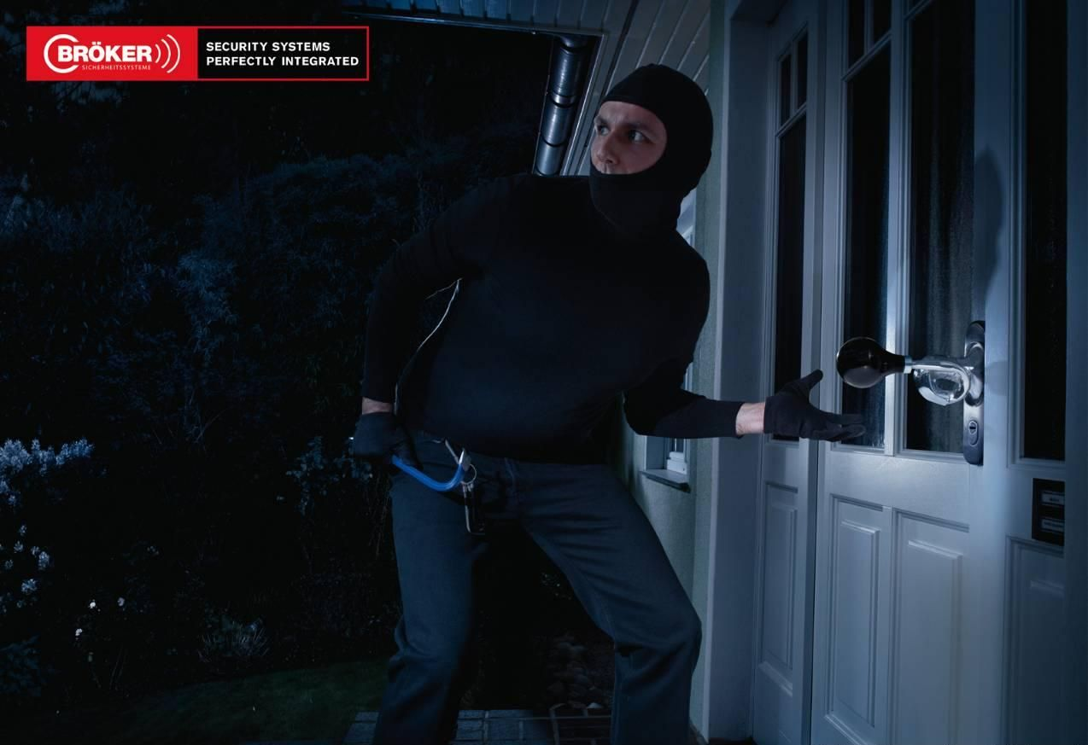

Safety and security Needs
What product / service is being advertised?
The product being advertised is the security system (in the form of an app) by Surf Easy
How does it match Maslow’s Hierarchy of Needs?
This advertisement matches the hierarchy because a safety and security need includes property.
Is the advertisement effective? Why or why not?
This advertisement is somewhat effective since it shows that the burglar is going to break into the house but the handle is playing like an alarm. This metaphor is like a security system that secures your house at the most crucial times, such as the night.

Slide 4
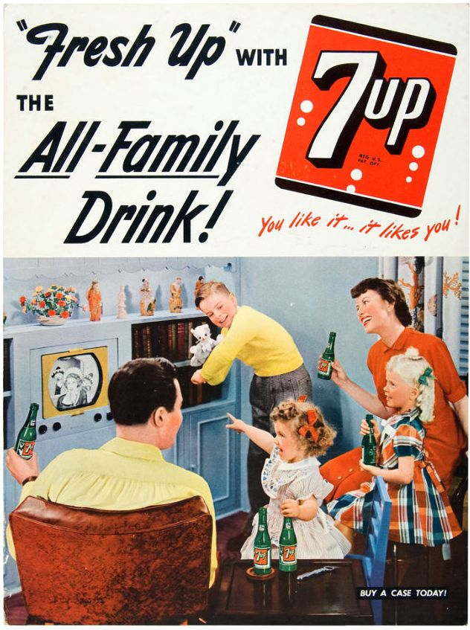
Love and Belonging Needs
What product / service is being advertised?
The product being advertised is an “All-Family Drink called 7up
How does it match Maslow’s Hierarchy of Needs?
This advertisement matches the hierarchy because it shows how their product is an all family product where people of all ages can enjoy it. This increased to the sense of connection, particularly in the family setting.
Is the advertisement effective? Why or why not?
This advertisement is very effective in my opinion because it shows a very stereotypical household in 1990s and many could see themselves drinking a 7up at their houses with their children.

Slide 5
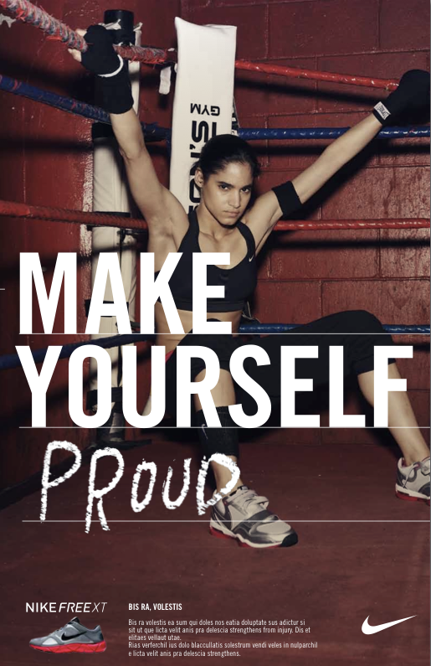
Self-Esteem Needs
What product / service is being advertised?
The product being advertised is Nike’s shoes called the NIKE FREE XT
How does it match Maslow’s Hierarchy of Needs?
This advertisement matches the hierarchy because it shows how you can be like the person in the picture and gain confidence from within.
Is the advertisement effective? Why or why not?
This advertisement is somewhat effective when it comes to the sales of the product in the advertisement since people know that buying the shoes in the picture is not going to make yourself more proud of yourself. But, many may have taken the advertisement more serious and when out to but these pairs of shoes.

Slide 6
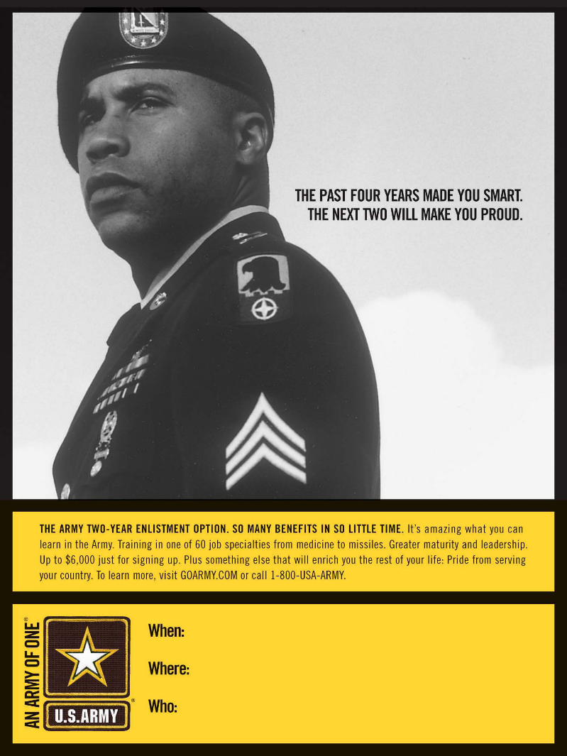
Self-Actualization
What product / service is being advertised?
The service being advertised is the U.S. Army job.
How does it match Maslow’s Hierarchy of Needs?
This advertisement matches the hierarchy because it clearly shows that in your life you have been learning, and now you have the opportunity to make yourself proud and find another purpose for yourself you might of thought you didn’t have.
Is the advertisement effective? Why or why not?
In my opinion, I believe that this advertisement is effective to those who don’t really have their life sorted out. This may seem like a correct profession for many who don’t want to proceed with post-secondary education. Along with that, you also get a proud feeling because you are doing something that benefits your country.

Slide 7
The End
Sukhdeep Chopra

